Slide 1
Cyberbullying Detection on Social Media Platforms Using Machine Learning
Team Members
Name
Exam Roll
Tanzila Akter
Nurun Nahar Fiha
Md. Parvej Hoque Palash
Serajum Monira
Md. Sakib Mollah
191325
191342
191357
181316
191365
CYBERBULLYING

Slide 2
Table of Content
Introduction
Objectives
Data Set Description
Methodology
Model Evaluation and Analysis
Conclusion
References

Slide 3
Introduction
Facebook
Twitter
In today's world, social media has become a big part of our lives, connecting people in various ways. Unfortunately, this increased use of social media has also led to more cases of cyberbullying, where people are targeted with harmful messages related to their sexuality, religion, politics, geopolitical or personal life.
Cyberbullying or Cyber-harassment is a form of bullying or harassment using electronic means.
By contrast, 25 percent or less of cyberbullying targets say they’ve been bullied on Twitter, Instagram, YouTube, Snapchat, and other social platforms.
YouTube
Instagram
Other Social media
Snapchat

Slide 4
Objectives
This research aims to build a model using machine learning and train it properly so that it can help to identify the comments on SNS and help those victims who suffered from cyberbullying to take legal action.
The main objective of our project is to identify the cyberbullying text using several machine learning approaches and find out the best model that works better in detecting cyberbullying text.

Slide 5
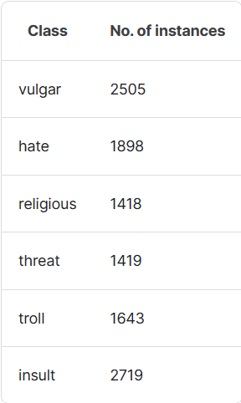
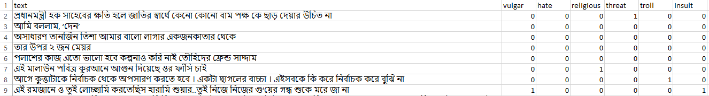
Dataset Description
Title: Multi Labeled Bengali Toxic Comments (kaggle.com).
This dataset contains 6 categories of cyberbullying text data from social media platforms. A total of 16,073 Bangla text data was collected by web scraping. All the data are evenly distributed among vulgar, hate, religious, threat, troll, insult where each sample text can be in multiple labels. There are 7 attributes in this dataset – text, vulgar, hate, religious, threat, troll and Insult. Usability: 9.41

Slide 6
Methodology
Data Preprocessing Phase
Dataset
Comments on SNS
Dataset Labeling
Stopwords Removal
Word Tokenization
Digit Removal
Punctuation removal

Slide 7
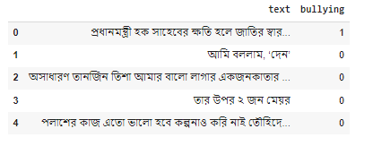
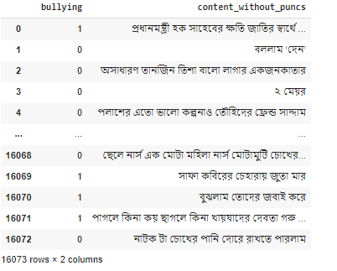
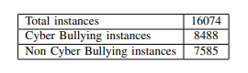
Methodology (Cont)
Data Preprocessing Phase Output
Fig 01: Instances Labeling
Fig 02: Instances Description
Fig 03: Stopwords Removal

Slide 8
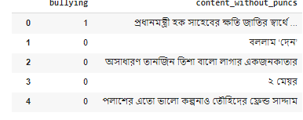
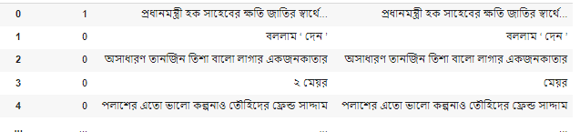
Methodology (Cont)
Data Preprocessing Phase Output
Fig 04: Punctuation Removal
Fig 05: Digit Removal

Slide 9
Methodology (Cont)
Evaluation Phase
Split Validation(80:20 dataset)
Training Set(80%)
Testing Set(20%)
Evaluation
Logistic Regression
Decision Tree
Random Forest
SVM
Confusion Matrix
Performance Evaluation

Slide 10
Model Evaluation & Analysis
In our research, among Logistic Regression, Decision Tree, Random Forest and Support Vector Machine, Decision Tree performed the poorest, whereas Support Vector Machine performed best.
The Random Forest performed batter then Decision Tree classifier as it is an extension of the Decision Tree Classifier, averaging out results of multiple recursion of the same. Here giving a performance table of Supervised Methods:
 | Decision Tree | Logistic Regression | Support Vector Machine | Random Forest
Accuracy | 0.736547434 | 0.81150855 | 0.80808709 | 0.792982549
Precision | 0.752954418 | 0.79290853 | 0.79053011 | 0.792982549
Recall | 0.761168385 | 0.88373425 | 0.87972509 | 0.791912908
F1 Score | 0.757039121 | 0.835861321 | 0.832718057 | 0.792447367

Slide 11
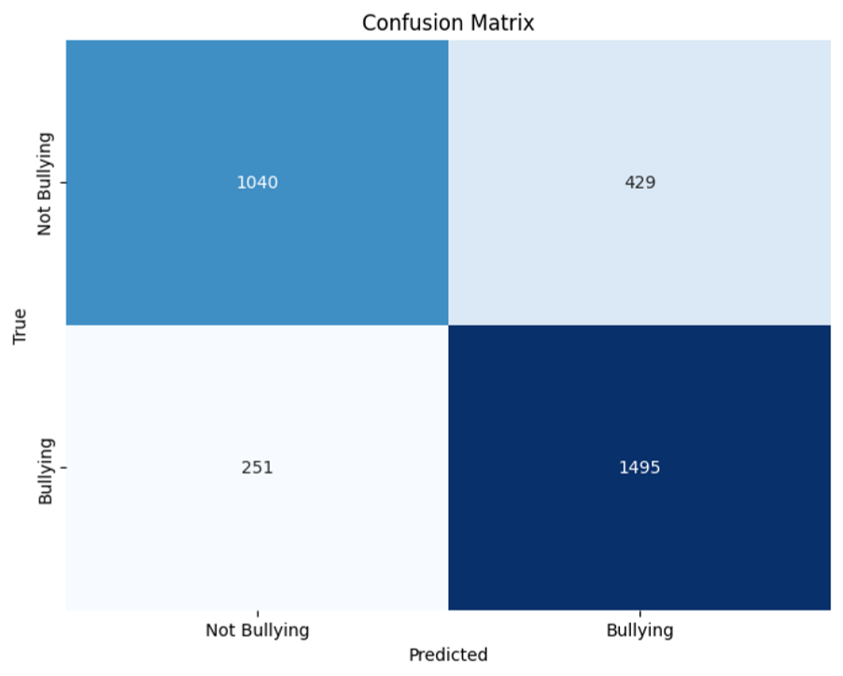
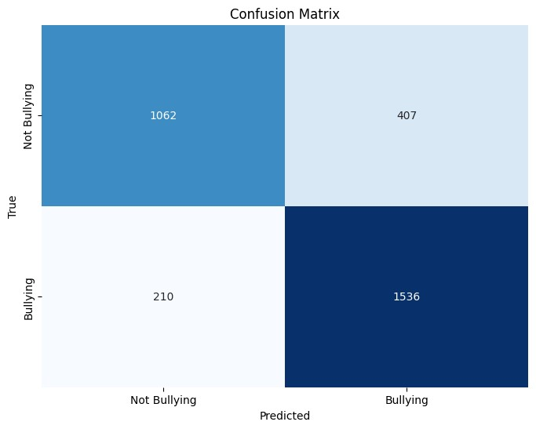
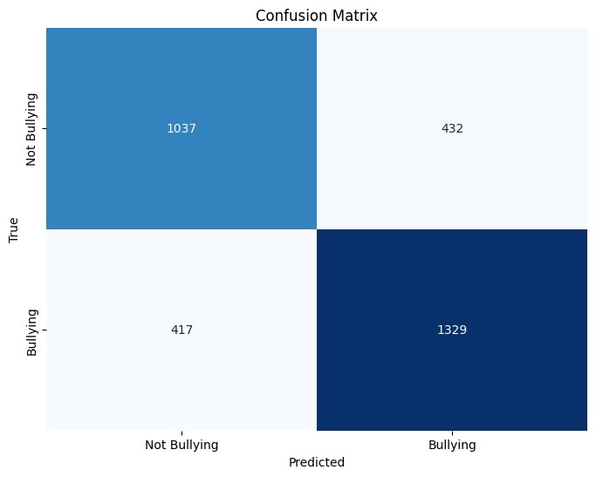
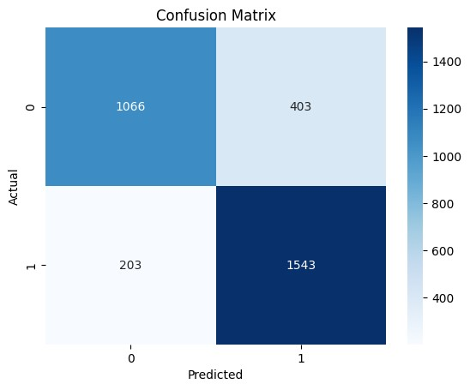
Model Evaluation & Analysis (Cont)
Confusion matrix for Logistic Regression
Confusion matrix for Decision Tree
Confusion matrix for Support Vector Machine
Confusion matrix for Random Forest

Slide 12
Model Evaluation & Analysis (Cont)
We chose CV = 10 for cross-validation to ensure robust evaluation of the models.
Logistic Regression(Cross-validation scores): [0.8028607, 0.81281095, 0.80721393, 0.81331674, 0.81331674, 0.81144991, 0.80460485, 0.8226509, 0.80211574, 0.81829496].
Mean cross-validation score: 0.8108635416569919.
Support Vector Machine(Cross-validation scores): [0.79850746, 0.81654229, 0.81218905,0.82389546, 0.80958307, 0.81953951, 0.8089608,0.81953951, 0.81082763, 0.81953951]
Mean cross-validation score: 0.8139124306903565.
Decision tree(Cross-validation scores): [0.75186567, 0.75808458, 0.75248756, 0.75233354, 0.74113255 0.72806472, 0.73242066, 0.75482265, 0.72868699, 0.7423771]
Mean cross-validation score: 0.744227601878597.
Random Forest(Cross-validation scores):[0.78420398, 0.8090796, 0.79042289, 0.80647169, 0.80087119, 0.79713752, 0.79838208, 0.80273802, 0.78282514, 0.80149347]
Mean cross-validation score: 0.797362557158204
SVM has the highest mean cross-validation score (0.8139), followed closely by Logistic Regression (0.8109), Random Forest (0.7974), and Decision Tree (0.7442). SVM and Logistic Regression show relatively consistent performance across folds, with smaller variability compared to Decision Tree and Random Forest

Slide 13
Conclusion
To sum up, our research examined how well different machine learning models identified cyberbullying in text data written in Bengali. Support Vector Machine (SVM) was the best performing model among those examined; it demonstrated good accuracy and stable performance at various folds. All in all, our results highlight the importance of employing advanced machine learning techniques to tackle social issues in the digital space.

Slide 14
References
[1] Cyberbullying. (n.d.). https://en.wikipedia.org/wiki/Cyberbullying
[2] Cyberbullying – Law and Legal Definitions US Legal.
[3] An Educator’s Guide to Cyberbullying Brown Senate.gov, archived from
the original on April 10, 2011
[4] E. J. K. S. T. P. R. A. Eri Eli lavindi, ”Cyber-bullying Detection based on Machine Learning Method(CaseStudy: Instagram Comment Section),”Journal of Applied Information and Communication Technologies, vol.8, pp. 223-226, 2023.
[5] N. B. a. M. H. H. Rahman, ”Toxicity Detection on Bengali Social Media Comments using Supervised Models,” in 2019 2nd International Conference on Innovation in Engineering and Technology (ICIET),
Dhaka, Bangladesh, 23-24 December 2019.

Slide 15
References(Continue)
[6] M. R. M. H. N. a. S. M. M. H. C. S. Ahammed, ”Implementation of Machine Learning to Detect Hate Speech in Bangla Language,” 8th International Conference System Modeling and Advancement in Research Trends (SMART), India,doi:10.1109/SMART46866.2019.9117214, pp. 317-320, 2019.
[7] K. A. U. a. M. M. A. P. A. Akhter, ”Cyber Bullying Detection and Classification using Multinomial Naive Bayes and Fuzzy Logic,” Int. J. Math. Sci. Comput, vol. 5, no. doi: 10.5815/ijmsc.2019.04.01, p. 1–12, 2019.
[8] S. B. C. a. A. H. R. R. Dalvi, ”Detecting A Twitter Cyberbullying Using Machine Learning,” 2020 4th International Conference on Intelligent Computing and Control Systems (ICICCS), Madurai, India no. doi: 10.1109/ICICCS48265.2020.pp. 297-301, 202

Slide 16
THANKS!
THANKS

